Slide 1
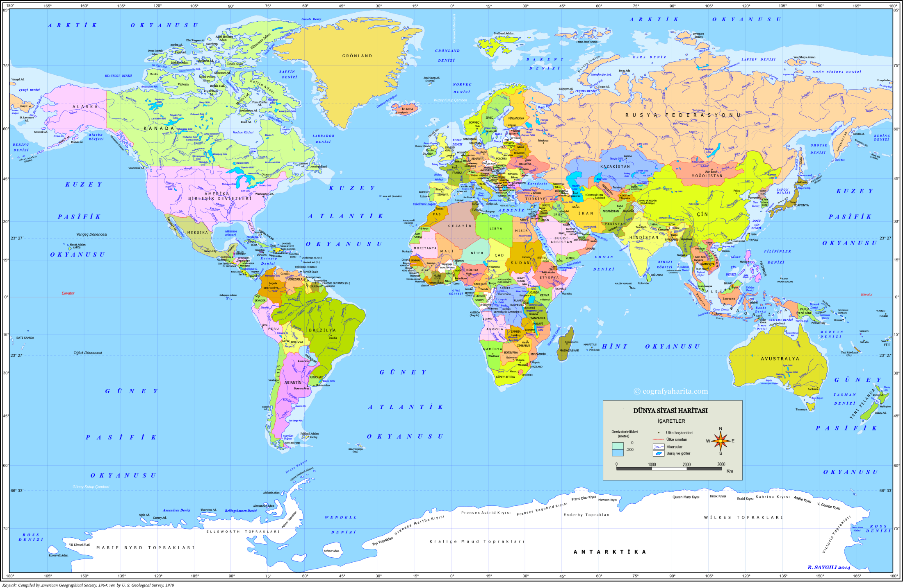
Assoc. Prof. Cem Doğan Yaşat
Mimar Sinan University, Istanbul
Assist. Prof.Tanzer Yakar
Sakarya University, Sakarya
Assoc. Prof. Muharrem Hafız
Istanbul University, Istanbul
Assist. Prof. Özge Ekin
Frei Universität Berlin, Berlin
Assoc. Prof. Lale Levin Basut
Yeditepe University, Istanbul
Assist. Prof. Hatice Işıl Şenol
Athens State University, Atina
Asist. Prof. Dila Gümüş
Istanbul Üniversitesi, Istanbul
Assist. Prof. Melike Durmaz Yeditepe University, Istanbul
Assist. Prof. Nazım Göker
Kilis 7 December University, Kilis
Assist. Prof. Burak Keskin
Beykent University, Istanbul
Assist. Prof. Hikmet Ünlü
Middle East Techical University, Ankara

Slide 3
INSTITUTIONS OUR GRADUATES WORK Below are some of the institutions that our graduates work:
IDO
credit and dormitories agency
FEDEK
PEGASUS PUBLISHING
KAYNAK PUBLISHING
AKIL İŞLERİ advertIsIng agency
MCCANN ERICKSON ISTANBUL
CHARM MUSIC CZ
STUDIO MODERNA
KADIKÖY MUNICIPALITY
VISIONS PRODUCTION SERVICES
DOĞA COLLEGE
VİZYON COLLEGE
MERİDYEN COLLEGE
FOUR TWO TR
ATAŞEHİR MUNICIPALITY
DORUK PUBLISHING
ALARKO TOURISM GROUP
KÜLTÜR BASIC HIGH SCHOOL
CITY ON A HILL CHARTER PUBLIC SCHOOL
AVRUPA COLLEGE
INTERNATIONAL CATHOLIC MIGRATION COMISSION – ICMC
ANADOLU GROUP STEEL ENGINE
ALTINBAŞ jewellery
TURKISH AIRLINES
TRT FOREIGN PRODUCTION
Association for Supporting Contemporary Life

